Slide 1
REMOTE AMBULANCE
SERVICE

Slide 2
National Highways
No. of accidents per-year state wise .
Bar graph indicating the avg. growth rate of accidents .
Top 4 states having highest accident growth rate studied extensively.

Slide 3
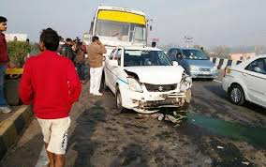
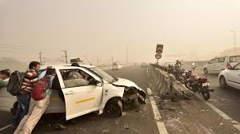
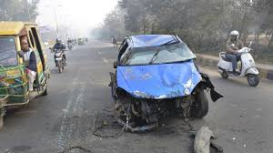
With road accident causing 207551 deaths annually India has one of the worst road traffic accident rate in the world .

Slide 4
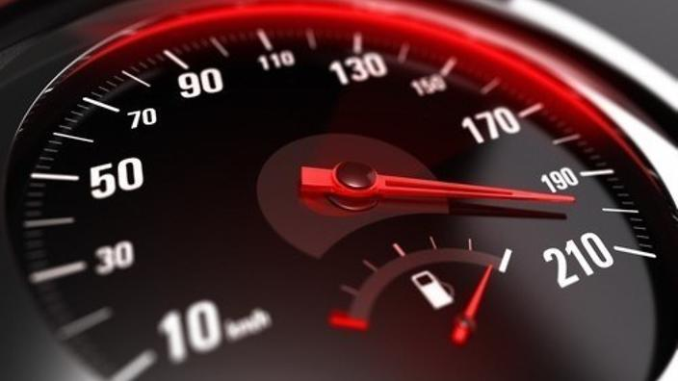

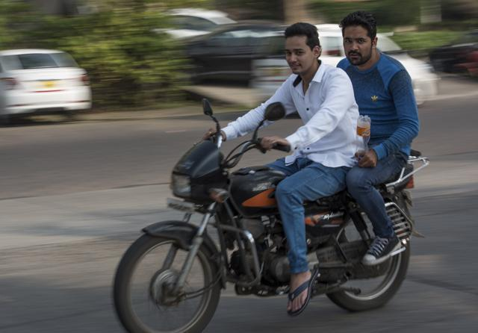
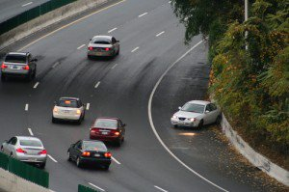
SPEEDING
DISTRACTED DRIVING
AVOIDING SAFETY GEAR
UNSAFE LANE CHANGES

Slide 5
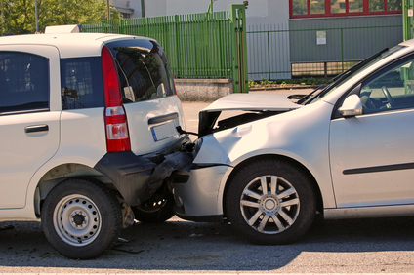
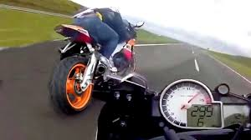
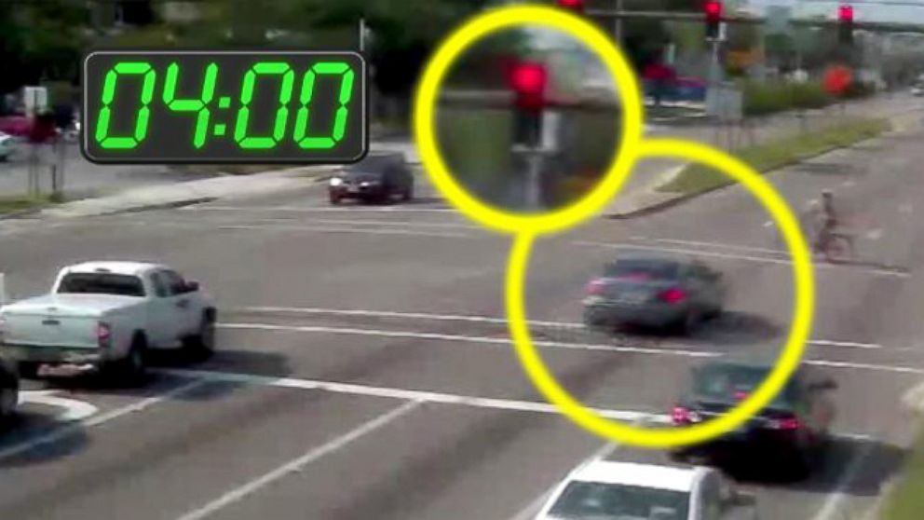
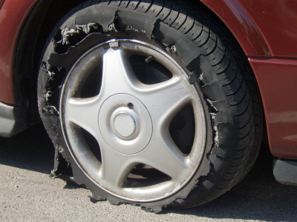
TAILGATING
STREET RACING
RUNNING RED LIGHTS
VEHICLE FAILURE

Slide 6
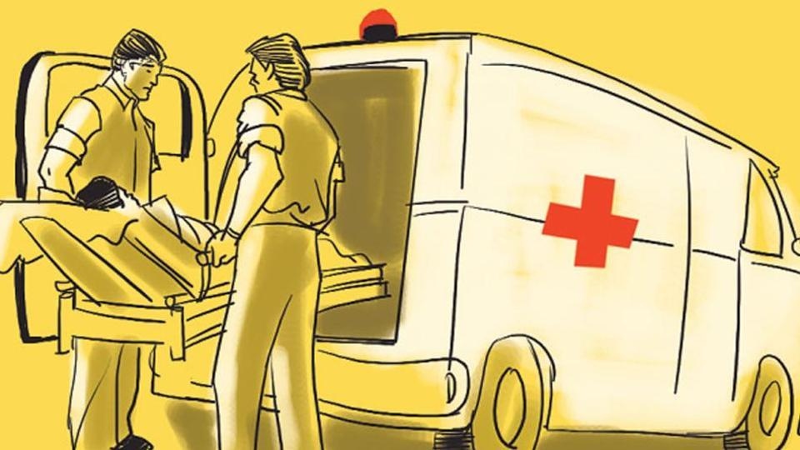
With the help of data analytics tools we intend to provide a solution !

Slide 8
TOOLS USED
visme
python
MICROSOFT EXCEL
microsoft POWERPOINT

Slide 9
THANK YOU

